Slide 1

Chapter 6
Discrete-Time Analysis of GI/GI/1
Performance Evaluation of the Internet of Things (IoT)
Module Course: Performance Evaluation of Distributed Systems
Prof. Tobias Hoßfeld, Summer Semester 2022

Slide 2

Disclaimer and Copyright Notice
Lecture slides, figures, and scripts are based on the open access text book “Performance Modeling and Analysis of Communication Networks”. The book and scripts are licensed under the Creative Commons License Attribution-ShareAlike 4.0 International (CC BY-SA 4.0). If you remix, transform, or build upon the material, you must distribute your contributions under the same license as the original.
The book must be cited and the disclaimer attached when using lectures slides or scripts.
Tran-Gia, P. & Hossfeld, T. (2021). Performance Modeling and Analysis of Communication Networks - A Lecture Note. Würzburg University Press. https://doi.org/10.25972/WUP-978-3-95826-153-2
Website to download book, exercises, slides and scripts: https://modeling.systems/

Slide 3
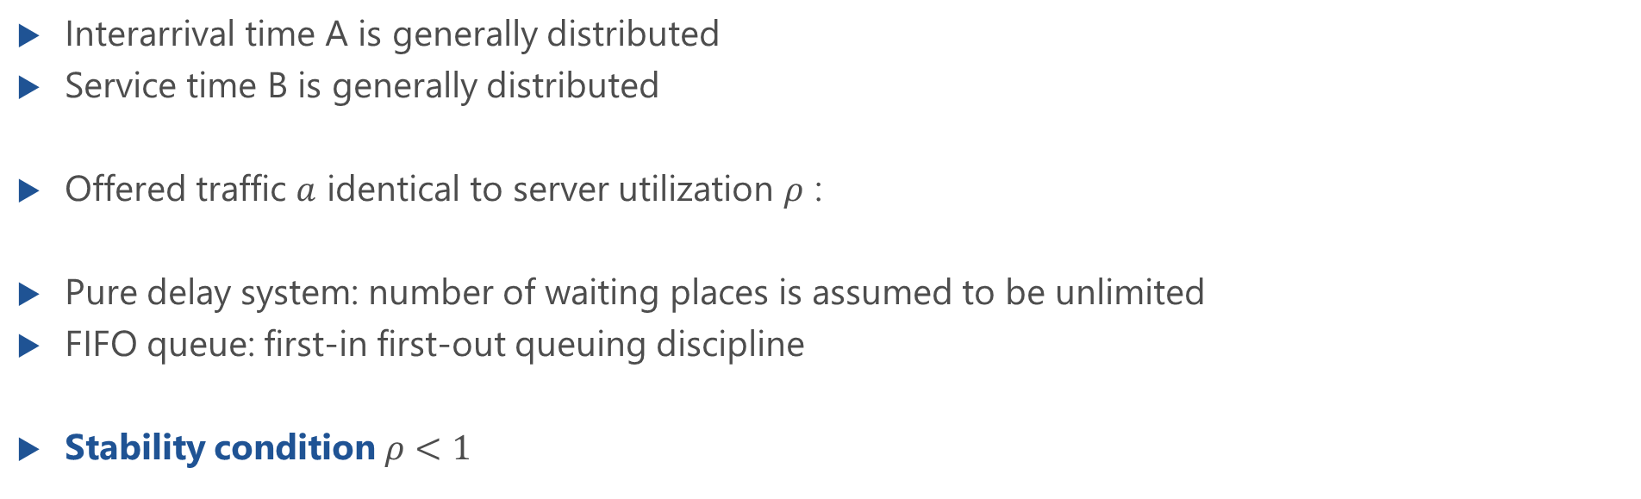
Discrete-Time Delay System GI/GI/1
Interarrival time A is generally distributed
Service time B is generally distributed
Offered traffic $a$ identical to server utilization $ρ$ :
Pure delay system: number of waiting places is assumed to be unlimited
FIFO queue: first-in first-out queuing discipline
Stability condition $ρ<1$

Slide 4
Sample Path of Unfinished Work in GI/GI/1 System

Slide 5
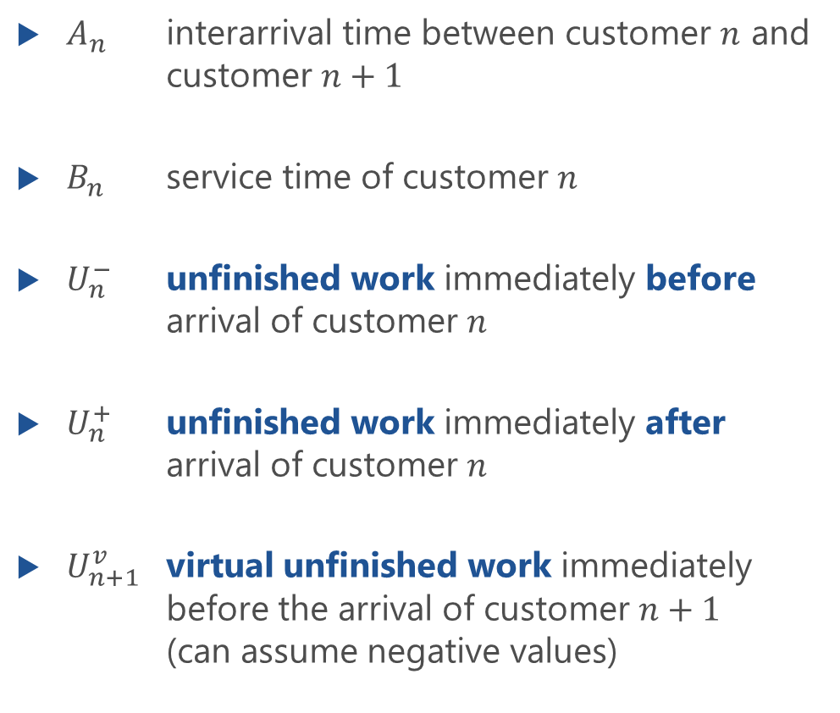
Notation of (Discrete) Random Variables
$A_{n}$ interarrival time between customer $n$ and customer $n+1$
$B_{n}$ service time of customer $n$
$U_{n}^{−}$ unfinished work immediately before arrival of customer $n$
$U_{n}^{+}$ unfinished work immediately after arrival of customer $n$
$U_{n+1}^{v}$ virtual unfinished work immediately before the arrival of customer $n+1$ (can assume negative values)

Slide 6
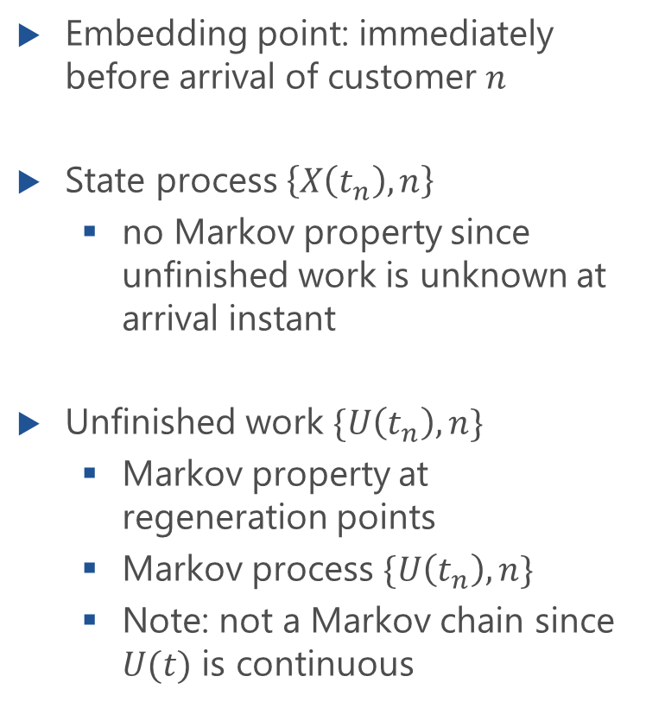
GI/GI/1 State Process
Embedding point: immediately before arrival of customer $n$
State process $\left\{X\left(t_{n}\right), n\right\}$
no Markov property since unfinished work is unknown at arrival instant
Unfinished work $\{U\left(t_{n}\right),n\}$
Markov property at regeneration points
Markov process $\{U\left(t_{n}\right),n\}$
Note: not a Markov chain since $U(t)$ is continuous

Slide 7
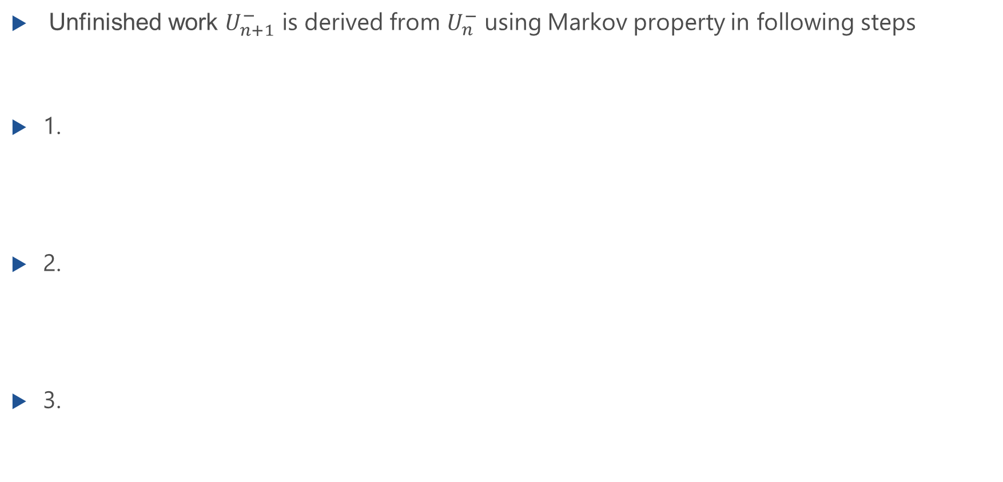
Analysis in Time Domain
Unfinished work $U_{n+1}^{−}$ is derived from $U_{n}^{−}$ using Markov property in following steps
1.
2.
3.

Slide 8
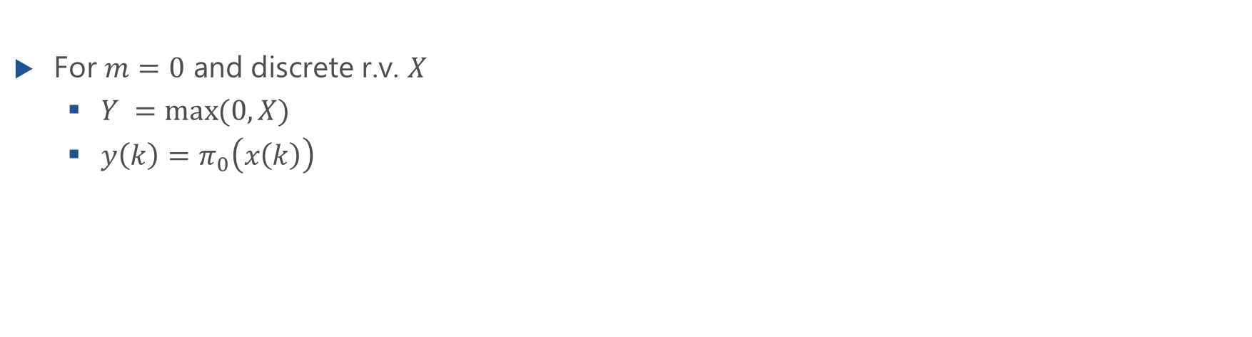
$π$ Operator for Discrete Random Variables
For $m=0$ and discrete r.v. $X$
$Y =\max{(0,X)}$
$y\left(k\right)=π_{0}\left(x\left(k\right)\right)$
x(k)
0
1
2
k
π
(
x(k)
)
0
0
1
2
k

Slide 9
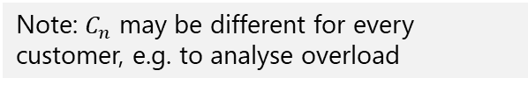
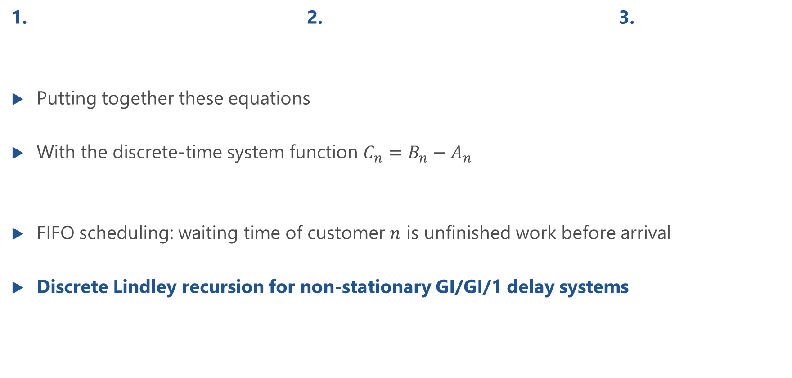
Analysis in Time Domain using $π$ Operator
1. 2. 3.
Putting together these equations
With the discrete-time system function $C_{n}=B_{n}−A_{n}$
FIFO scheduling: waiting time of customer $n$ is unfinished work before arrival
Discrete Lindley recursion for non-stationary GI/GI/1 delay systems
Note: $C_{n}$ may be different for every customer, e.g. to analyse overload

Slide 10
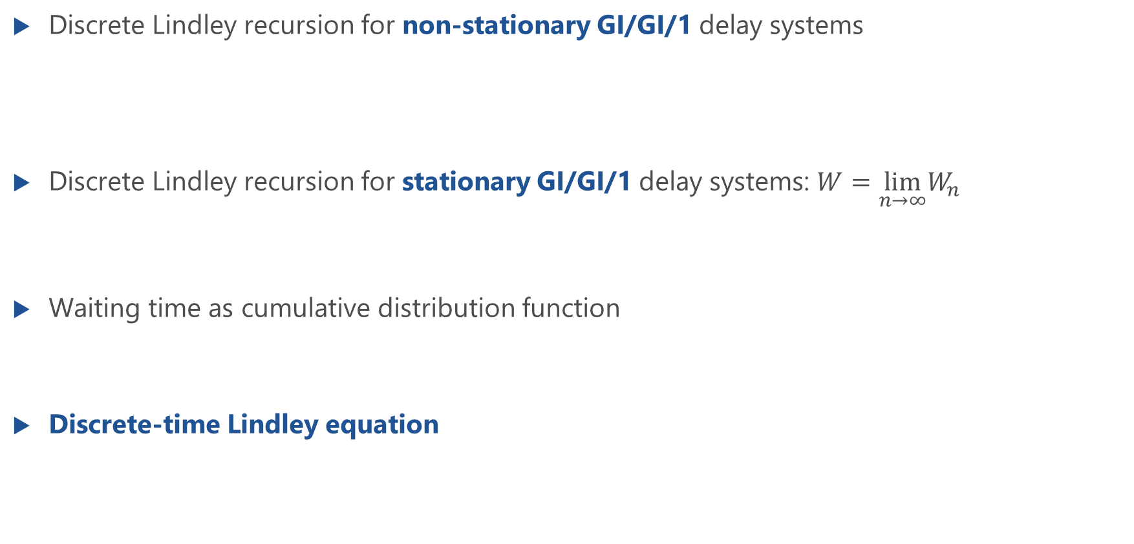
Lindley Recursion for GI/GI/1 Delay Systems
Discrete Lindley recursion for non-stationary GI/GI/1 delay systems
Discrete Lindley recursion for stationary GI/GI/1 delay systems: $W=\lim_{n→∞}W_{n}$
Waiting time as cumulative distribution function
Discrete-time Lindley equation

Slide 11
Computational Diagram for the Analysis of GI/GI/1
General form of Lindely’s integral equation in discrete-time domain
Algorithm for computation depicted as computational diagram

Slide 12
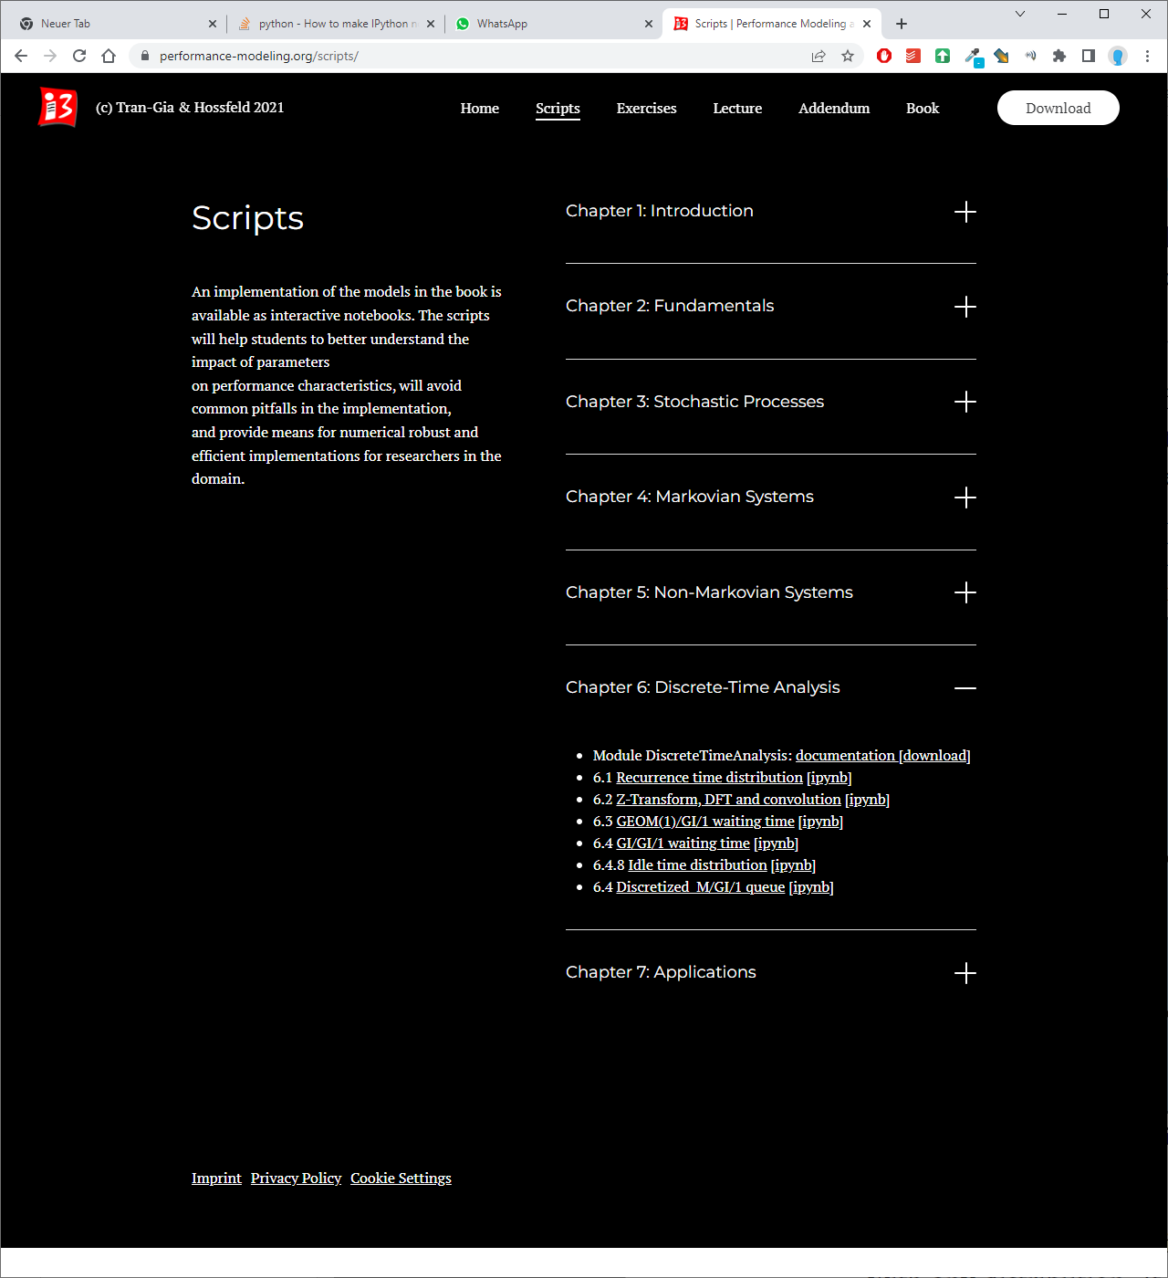
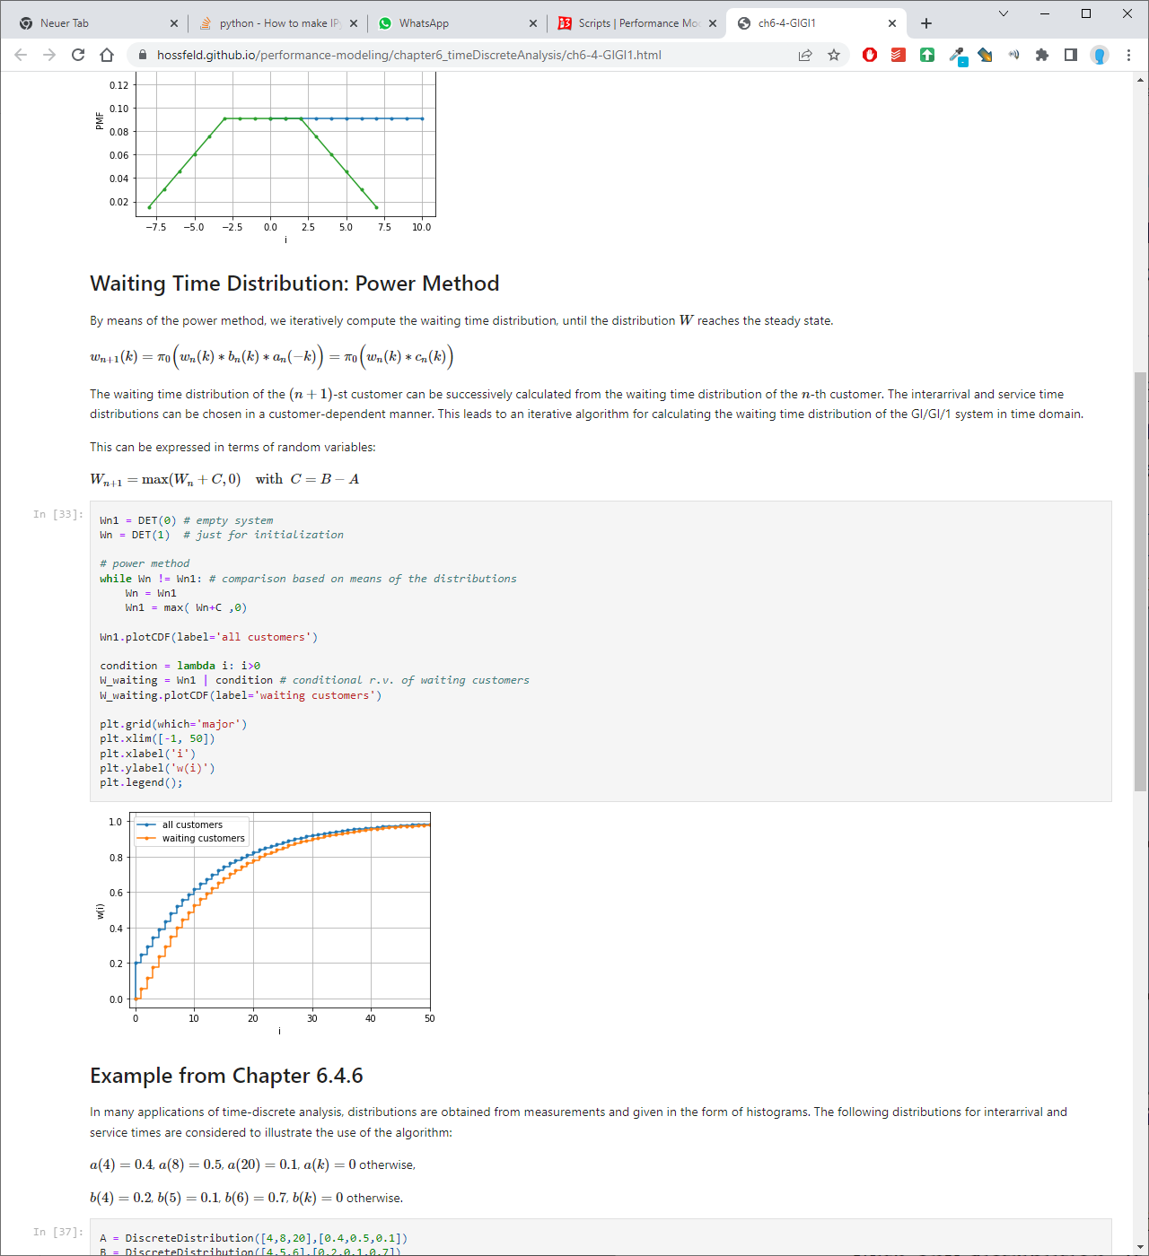
https://modeling.systems/

Slide 13
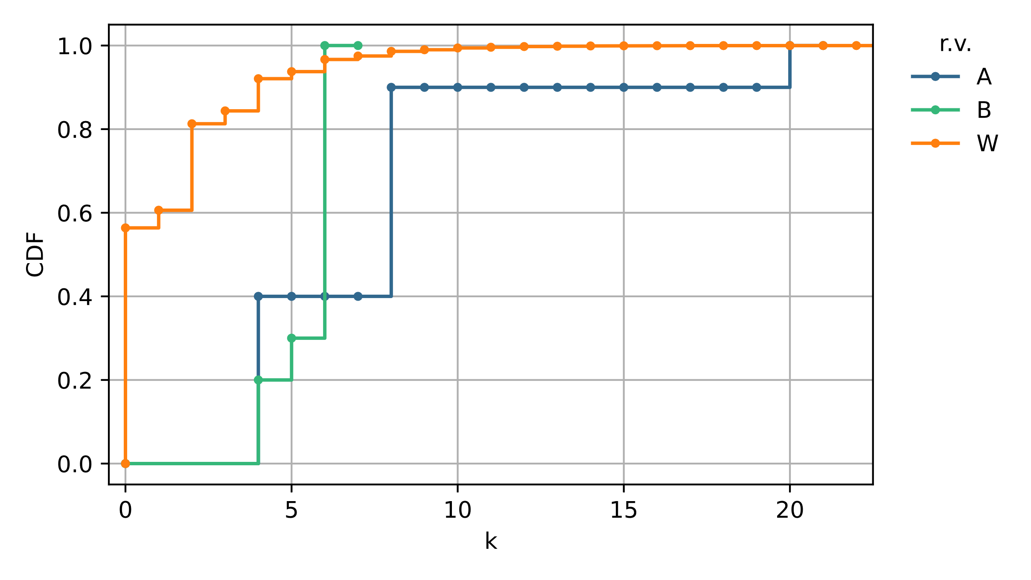
Numerical Example 1

Slide 14
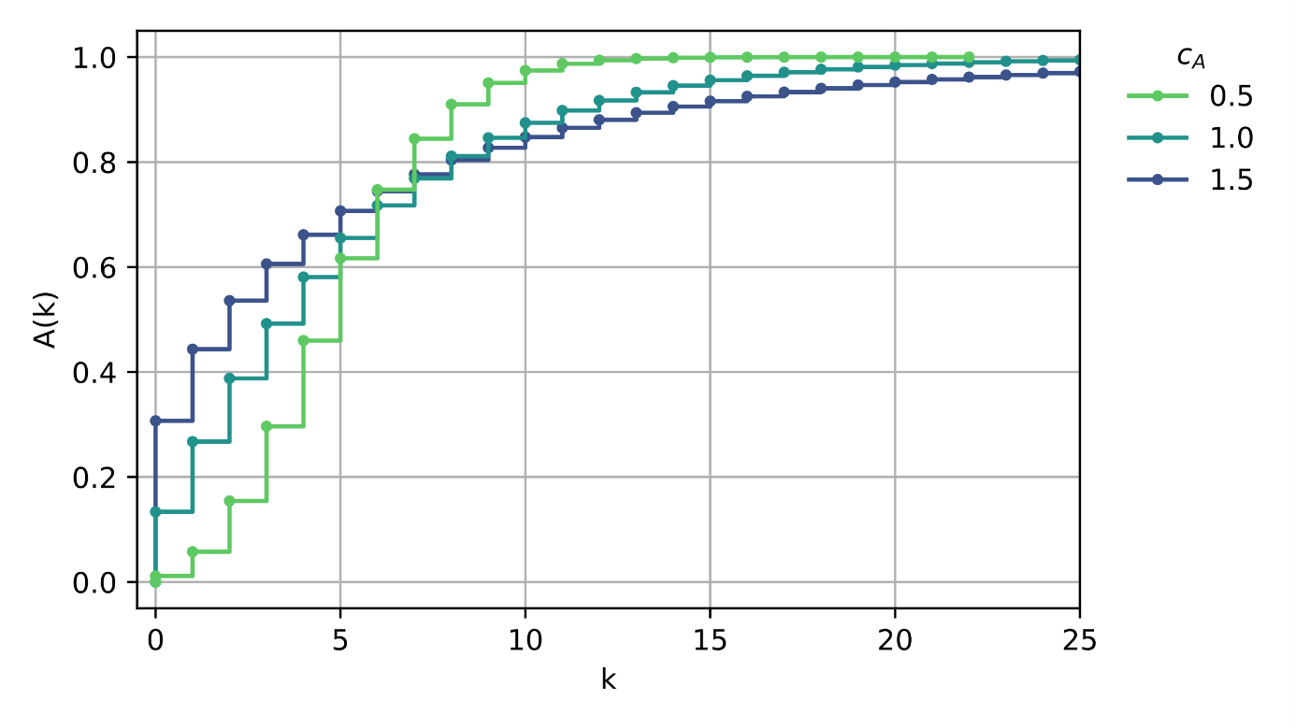
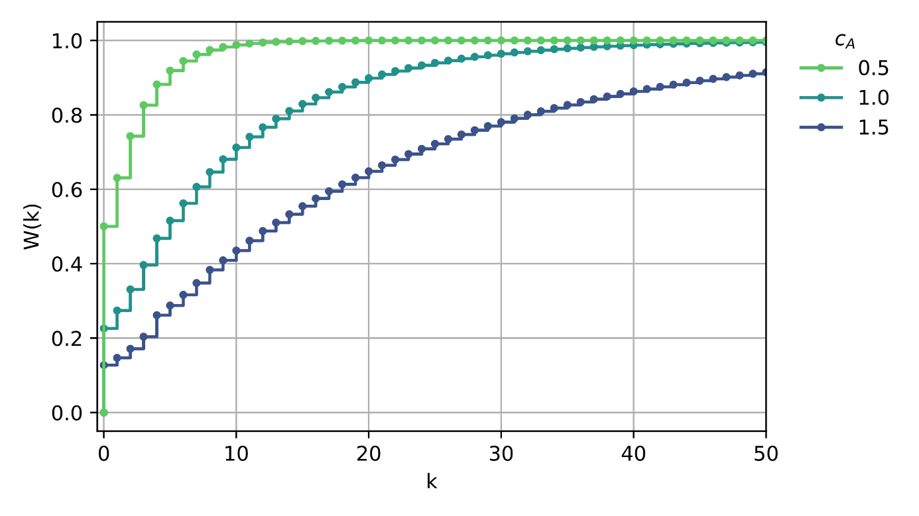
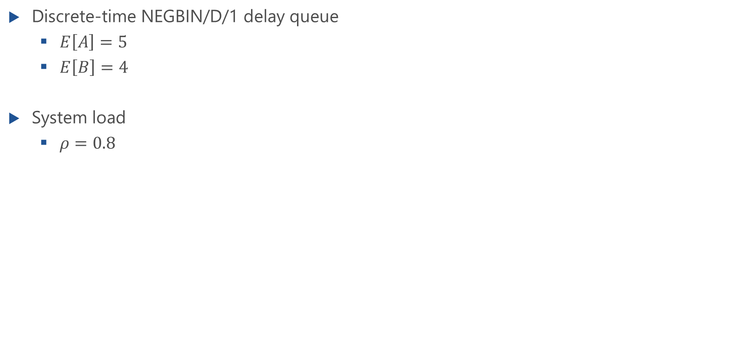
Numerical Example 2
Discrete-time NEGBIN/D/1 delay queue
$E\left[A\right]=5$
$E\left[B\right]=4$
System load
$ρ=0.8$

Slide 15
Idle Times and Interdeparture Times

Slide 16
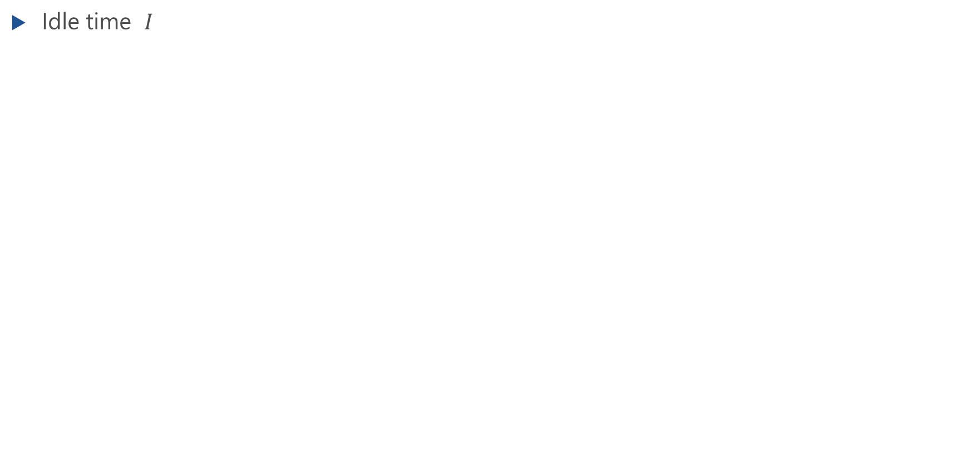
Derivation of Idle Time for GI/GI/1 Delay System
Idle time $I$

Slide 17
Idle Time Distribution
Analysis of idle times
Probability that a departure happens at the end of a busy period
Interdeparture time

Slide 18
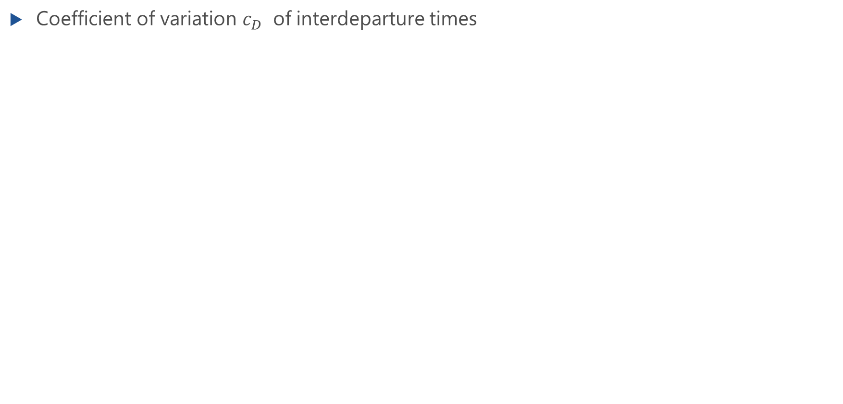
Output Process: Variation of Interdeparture Times
Coefficient of variation $c_{D}$ of interdeparture times

Slide 19
Characteristics of GI/GI/1
Kingman‘s approximation

Slide 20
Characteristics of GI/GI/1 Delay Systems
Stability condition
Utilization of the server $ρ=λE[B]$
Probability that server is idle = server is empty at arbitrary point in time
System state from perspective of arrivals

Slide 21
Characteristics of GI/GI/1 Delay Systems (f.)
Waiting probability
Mean number of customers in the system due to Little’s law
Mean waiting time
Note: There are no simple equations available for $x_{A}\left(0\right),E\left[I\right],E[X]$
Solution of Lindley integral equation required to derive those characteristics
derivation of waiting times for discrete-time GI/GI/1 queue

Slide 22
Lindley Integral Equation for Continuous GI/GI/1 Systems
For a GI/GI/1 system under stationary conditions, the following functional relationship for the waiting time distribution function are obtained $W\left(t\right)$: Lindley integral equation
System function $C=B−A$(r.v.) contains all parameters of stochastic process of GI/GI/1 queue
Probability density function Compact notation with

Slide 23
Kingman’s Approximation of Mean Waiting Times
Kingman provides an approximation for the mean waiting time: Kingman’s formula
For a Poisson process, Kingman’s formula is exact
Tighter upper bound of the mean waiting time is provided by Daley
Difference between upper bound and approximated mean
Relative difference

Slide 24
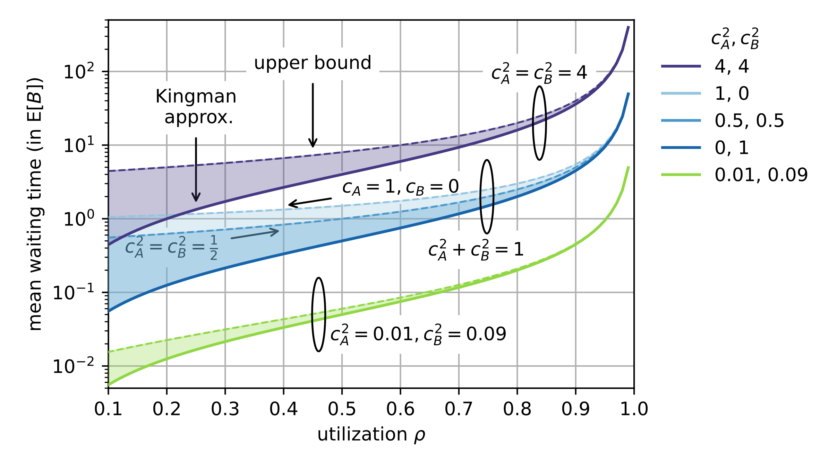
Kingman’s Approximation and Tight Upper Bounds

Slide 25
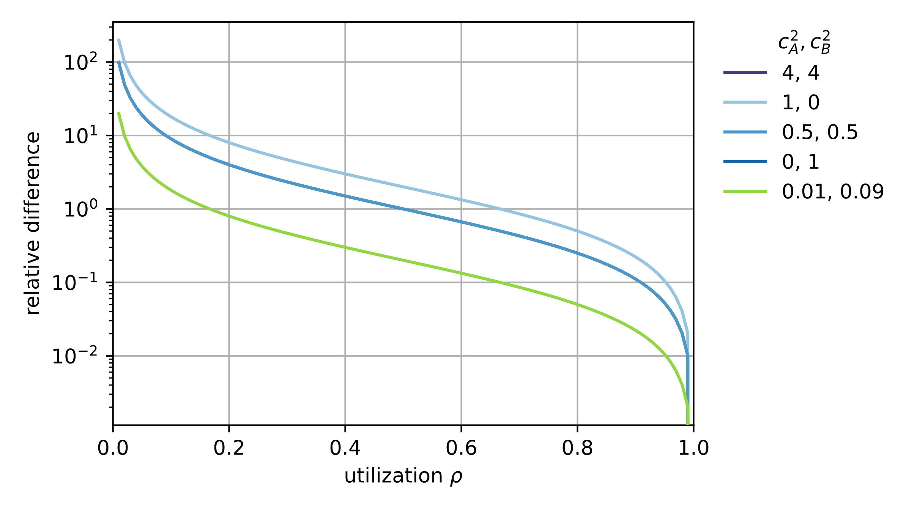
Relative Difference

